Slide 1
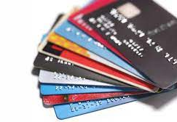
Credit card customer analysis
By: Shyam Patel
UIN: 678481784

Slide 2

Motivation/Background
Credit Card Company is facing problems on loosing credit card customers.
Requirement of an individual to be able to recognize habits leading to loss of customer.
Study the statistics of patterns which affect the clients on regular basis.
Proactively take measures to report problems and identify patterns
Take action by offering better services to retain the customer.

Slide 3
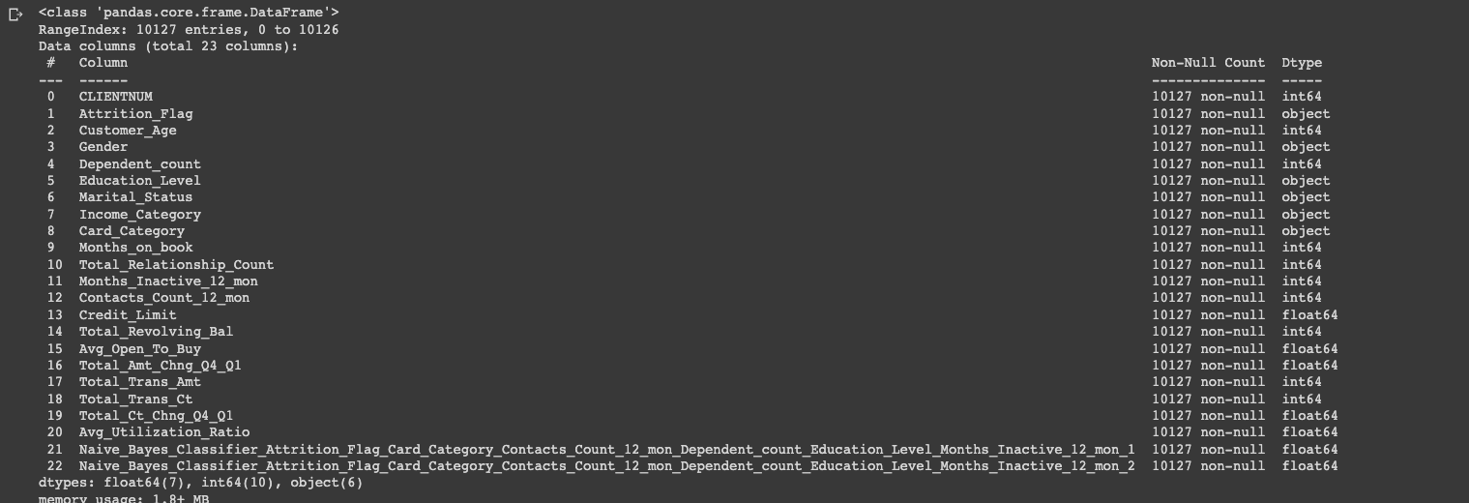

Slide 4

Data Set
Dataset was obtained from Kaggle
Now, this dataset consists of 10,000 customers mentioning:
Age
Salary
marital status
credit card limit
credit card category
etc. There are nearly 18 features.
We have only 16.07% of customers who have churned. Thus, it's a bit difficult to train our model to predict churning customers.

Slide 5
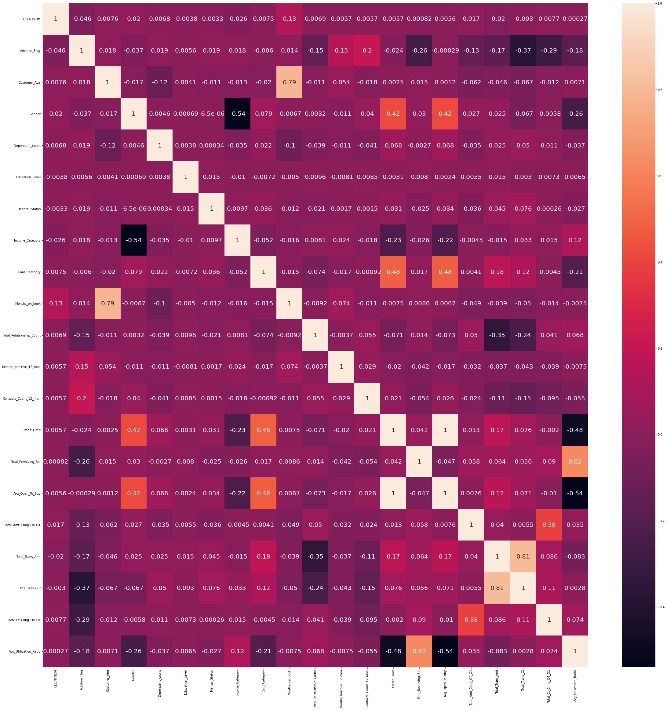
Analytics
Performed various matrix such as :
Feature selection
Train-test split
Standardization
It gave a cleared chart to use different models for performing different functions.

Slide 6
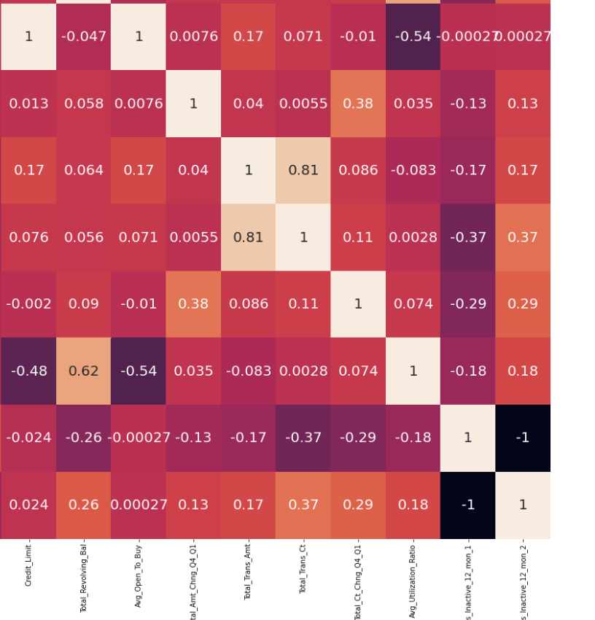
Correlation report Utilizing rows and columns to differentiate material value

Slide 7
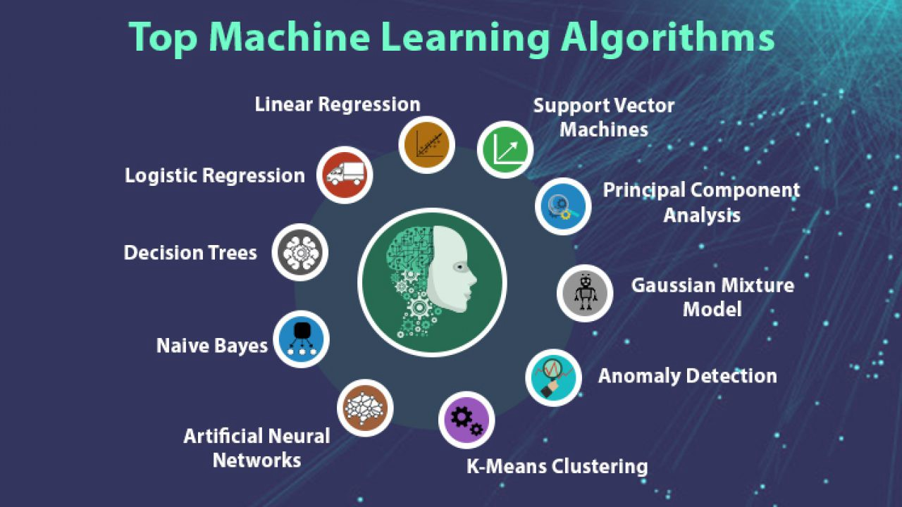
Model Preparation
Running different models
SVM
KNN
Logistic Regression
Random Forest

Slide 8
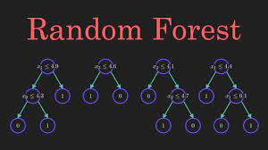
Results
SVM Accuracy = 93%
KNN Accuracy = 91%
Logistic Regression = 90%
Random Forest = 95%

Slide 9

Taking attributes and average.

Slide 10


Slide 11

Thank you!
In order to retain the customer, the company needs to provide credit based on income of greater than $50,000
School Students ranked the highest % for cancelling the credit cards.
Inactive users for more than 2 months were more like to cancel the cards.

